Slide 1
Skillforge
Vision and Scope

Slide 2
The aim
SkillForge aims to create an innovative educational platform where users can quickly acquire micro-skills in areas like IT, marketing, and design through short lessons, fostering flexible and practical learning.

Slide 3
PRODUCT OVERVIEW
Target Audience
Professionals and learners seeking fast, flexible skill development.
Main Goal
Efficient learning via short, practical lessons.

Slide 4
scope
Platforms
Mobile app and web platform, accessible online and offline.
Micro-skills Catalog
Categorized lessons across disciplines.
Personalized Learning
Adaptive course recommendations based on user activity.
Interactive Tasks
Practical exercises to apply learned skills.
Community Features
Users share achievements, engage in challenges, and collaborate.
Monetization
Free basic content, with premium subscriptions for advanced access.

Slide 5
NON-goals
No traditional long courses.
No direct instructor consultations (except in future premium versions).
No certification programs. Focus is on practical, applicable skills.
No deep theoretical content.

Slide 6
Scope Limitations
The platform will not offer in-depth, lengthy courses or certifications
No individual tutoring or specialized mentor programs at launch.
Initially limited to short, skill-focused content without offering extensive career paths or academic recognition.

Slide 7
Why skillforge should be
In modern society, there is a demand to learn different skills quickly. Our project aims to provide people with short and clear materials that will help them quickly learn new skills that they can immediately put into practice.

Slide 8

User Persona 1
Pavel(Student)
Who he is: A student/early-career professional, aged 18–25.
Problem: Lacks time for lengthy courses; wants to quickly acquire skills to stand out among competitors.
Goal: Quickly learn the basics (e.g., using Canva, understanding Python fundamentals).
How SkillForge helps him: Provides access to short, practical lessons that can be completed during a lunch break.

Slide 9

User Persona 2
Stanislav (Teacher)
Who he is: An expert in IT/design/marketing, aged 30–40.
Problem: Wants to share knowledge but is tired of delivering hour-long lectures.
Goal: Create short, focused lessons that deliver immediate practical results.
How SkillForge helps him: Offers a simple system for creating microcourses and a way to track students' success.
Use Cases for the SkillForge Platform

Slide 10
Use cases
Use case 1:
"Quickly Learning a Useful Skill"
Use case 2:
"Creating Micro-courses"
Use case 3:
"Gamifying the Learning Process"
Pavel:
Logs into the platform looking for "quick marketing training."
Finds a mini-course: "Creating Banners in Canva in 15 Minutes."
Watches the video tutorial and completes a task in Canva.
Receives system feedback on improving his result.
Outcome: In just 15 minutes, Pasha learns to create cool banners, which he can now use for his project.
Stanislav:
Registers as an instructor on the platform.
Downloads additional tools for course creation.
Creates a course: "SQL Basics in 10 Minutes."
Adds a practical task: "Write a query to retrieve data."
Gets feedback from students on how to improve his lessons.
Outcome: The course becomes popular, motivating Stanislav to create more lessons.
Pasha and Stanislav:
Pasha completes a course and participates in a challenge: "Write Your First SQL Query."
Stanislav tracks student progress and publishes the weekly leaderboard.
Pasha competes with other students to claim the top spot.
Outcome: Students are more motivated, and the courses become increasingly popular.

Slide 11
Functional and non-functional requirements
Personalized course recommendations
Social features
The system should analyze user activity and suggest courses relevant to their interests.
Enable users to share achievements, participate in challenges, and collaborate with others.
Interactive assignments
Course creation for instructors
Provide users with practical tasks they can complete to reinforce their skills.
The platform should allow instructors to easily create micro-courses and track student progress.
Online and offline availability
Gamification of the learning process
Courses should be accessible both online and offline on mobile devices.
Implement a system of challenges and leaderboards to boost user motivation.

Slide 12
Functional and non-functional requirements
High performance
Ensure fast page and material loading, even with a high number of users.
Usability
The interface should be intuitive and suitable for both students and instructors.
Data security
Protect users' personal information and ensure the security of payment data.

Slide 13
Project team
Role | Responsibility
Project Manager (PM) | Managing the project, planning the timeline, overseeing progress and risks.
Business Analyst | Gathering requirements, analyzing user needs, and prioritizing features.
UX/UI Designer | Designing the user interface and ensuring a positive user experience.
System Architect | Designing the system architecture and selecting technologies.
Back-End Developer | Implementing business logic, integrating databases, and APIs.
Front-End Developer | Creating a responsive user interface (web and mobile).
Software Tester (QA) | Verifying functionality and testing user experience.
DevOps Specialist | Deploying the application, maintaining environments, and automating processes.

Slide 14
Project timeline and schedule
Phase | Description | Time (w) | Dependencies | Details
Planning | Defining goals, requirements, and assigning roles. | 2 | None | Analysis of business and user requirements. Defining project priorities.
Design | Creating UI/UX and system architecture. | 3 | Planning | Designing the user interface (UI) and the technical architecture of the platform.
Development | Development of functionalities: catalog, personalization, tasks, community features. | 8 | Design | Implementation of core features: catalog, recommendations, interactive tasks, and community functions.
Testing | Testing functionality and user experience. | 3 | Development | Performing unit tests, integration tests, and UX/UI testing to identify errors.
Deployment | Launching the MVP version and post-launch support. | 2 | Testing | Launching the MVP version to the market and collecting user feedback for improvements.

Slide 15
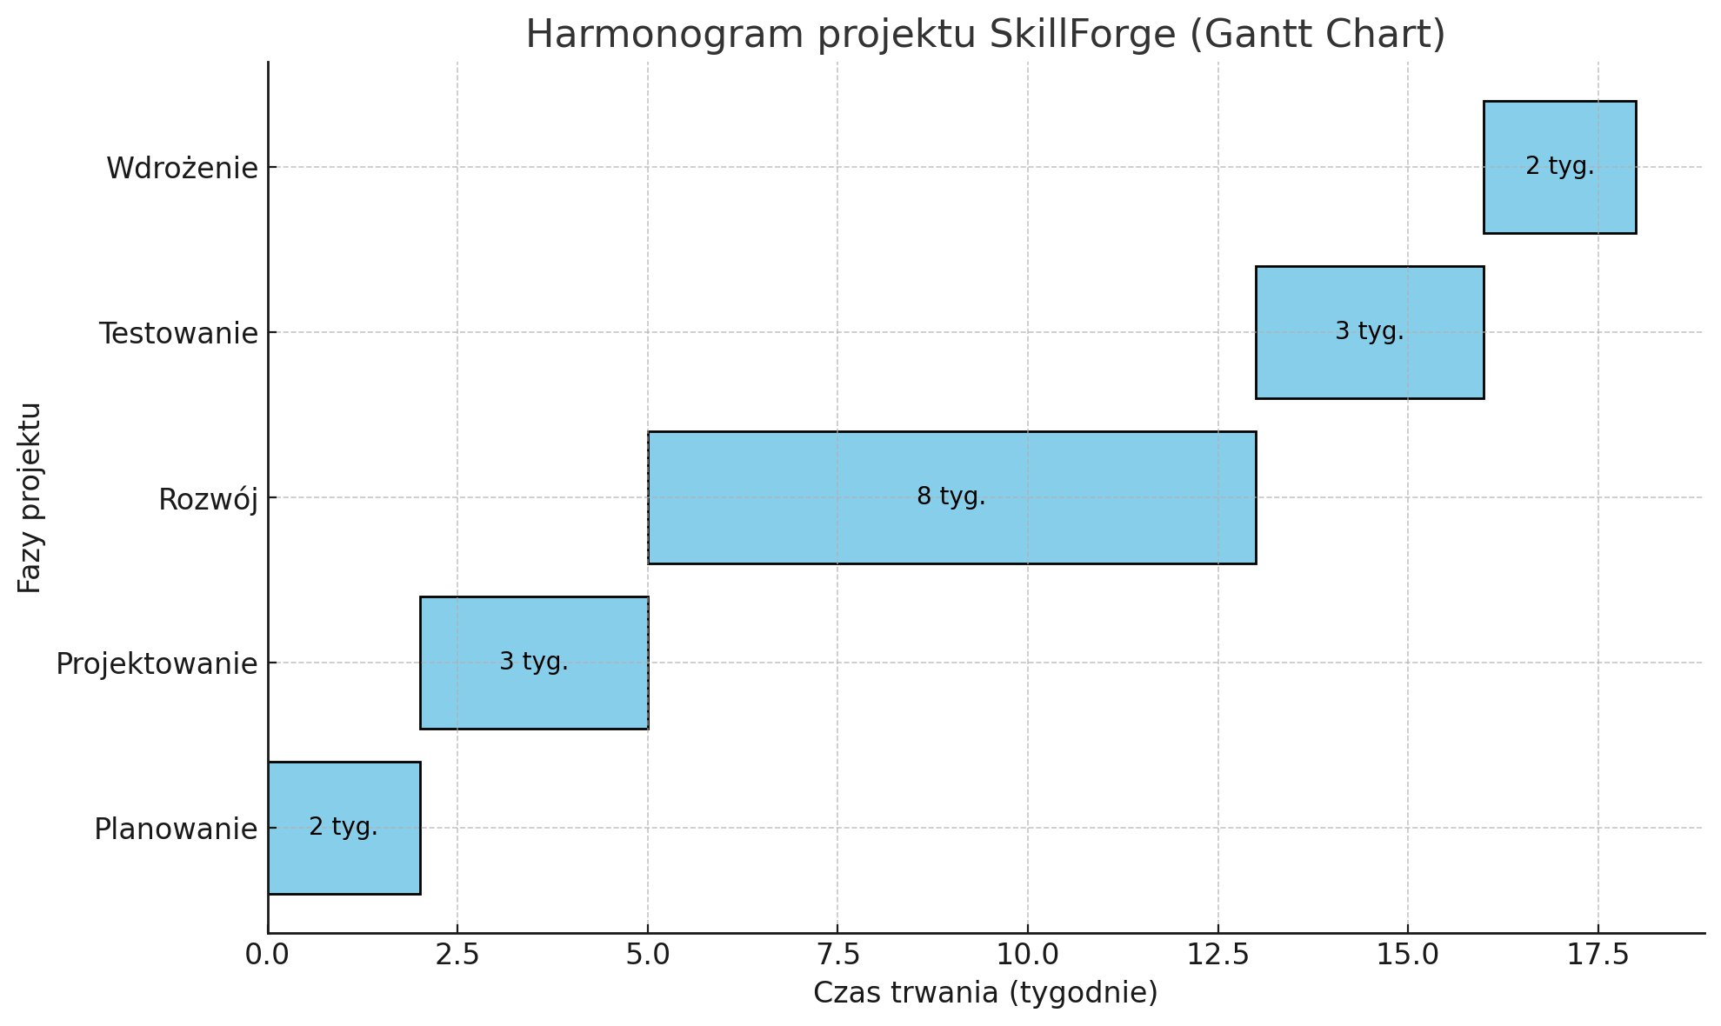
Gantt chart

Slide 16
Risk assessment and mitigation plan
Risk | Likelihood | Impact | Mitigation Strategy
1. Delays in feature development | High | High | Regular progress reviews and implementation of Agile sprints.
2. System integration issues | Medium | High | Early integration testing during development stages.
3. Lack of technical resources | High | Very High | Hiring additional developers or subcontractors.
4. Poor UX/UI quality | Medium | Medium | Conduct UX research and testing with MVP users.
5. Low number of users | Medium | High | Marketing and promotional campaigns at project launch.
6. Server downtime | Low | High | Implement redundancy plans and 24/7 server monitoring.
7. Changes in business requirements | Low | Medium | Document requirements and manage controlled backlog.
8. Offline functionality issues | Medium | Low | Conduct tests for users with limited access.
9. Translation errors in the app | Low | Low | Hire proofreaders and thoroughly test translations.

Slide 17
Identified Risks with High and Medium Likelihood:
Delays in Feature Development
System Integration Issues
Lack of Technical Resources
Impact: Delays in developing key features can slow down the entire project timeline, causing missed deadlines and increasing project costs. It could lead to dissatisfaction among stakeholders and delays in launching the product.
Impact: Integration challenges can cause delays in deploying the system, incompatibility between modules, or operational failures, potentially delaying the go-live phase.
Impact: A shortage of developers or skilled personnel can slow development progress, result in poor code quality, and delay project milestones.
Mitigation Strategy:
Implement regular progress reviews and Agile sprints to break tasks into smaller, manageable components.
Ensure clear communication among team members to identify roadblocks early.
Use project management tools to track progress and timelines effectively.
Mitigation Strategy:
Perform early integration testing during the initial development stages.
Collaborate with all stakeholders (developers, testers, etc.) to ensure clear documentation of integration points.
Use automated testing tools to detect and address integration issues quickly.
Mitigation Strategy:
Hire additional developers or subcontractors to fill resource gaps quickly.
Offer training to upskill existing team members to handle technical tasks.
Collaborate with freelance platforms to access on-demand talent when necessary.

Slide 18
Identified Risks with High and Medium Likelihood:
Poor UX/UI Quality
Low Number of Users
Offline Functionality Issues
Impact: A poor user experience (UX) and user interface (UI) can result in user frustration, lower adoption rates, and a high churn rate. It may harm the app's reputation and reduce revenue.
Impact: Low user acquisition can lead to revenue loss, poor product adoption, and eventual project failure if user growth is not achieved.
Impact: Limited functionality when offline can result in user dissatisfaction, particularly for users with inconsistent internet access, and may cause reduced app usage.
Mitigation Strategy:
Conduct UX research and iterative testing with MVP (Minimum Viable Product) users.
Gather user feedback to understand pain points and areas for improvement.
Apply design best practices and collaborate with experienced UX/UI designers.
Mitigation Strategy:
Launch marketing and promotional campaigns to attract users.
Use targeted advertising on social media and other platforms to reach the right audience.
Offer incentives such as discounts, free trials, or referral bonuses to encourage user growth.
Mitigation Strategy:
Conduct tests for users with limited access to evaluate offline performance.
Design key functionalities to work seamlessly in offline mode and sync data once online.
Improve caching mechanisms to enhance the user experience in offline scenarios.

Slide 19
Tooling Selection and Justification
JavaScript
React
Django
Visual Studio Code
Used for creating a dynamic and responsive frontend.
A frontend framework for building reusable UI components.
React was chosen because SkillForge is focused on creating an intuitive and personalized interface for users, including features like personalized course recommendations and gamified learning processes.
A backend framework ensuring security and development efficiency.
Django provides robust security and scalability, which is critical for SkillForge to protect user data (especially for personalized recommendations and payments).
The primary development environment, thanks to its user-friendly interface and extensions.
VS Code supports extensions for JavaScript, Python, and Git, which are essential for seamless development in the SkillForge environment.
Python
Applied for backend development and data analysis.
Discord
For team communication, virtual meetings and discussions.

Slide 20
Tooling Selection and Justification
Git + GitHub
GitHub Actions
Figma
Jira + Trello
Reliable version control is necessary for SkillForge, as the project involves multiple developers collaborating on a complex platform.
Automation is key to maintaining high performance for the platform.
GitHub Actions tests updates before release, ensuring users don’t encounter bugs during their learning experience.
Used for creating user interface designs and prototypes.
Figma is ideal for designing layouts because SkillForge needs a simple and accessible interface for both mobile and web users to enhance learning engagement.
For tracking tasks and project progress.
Jira handles larger tasks and milestones, while Trello is used for day-to-day task management in SkillForge, ensuring efficient progress tracking.

